Slide 1
Using your NuGet for Fun and Profit
Joel Hammond-Turner
E: joel.hammond-turner@landmark.co.uk
T: @Rammesses

Slide 2
Agenda
What is NuGet?
Why NuGet in the Enterprise.
NuGet within the Build Process.
Packaging & publishing your code with NuGet.
Public? Private? Where should I publish?
Who pulled the plug? Coping with outages.
Conclusions

Slide 3

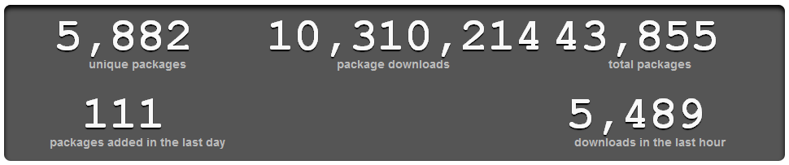
What is NuGet?
Hands up if…
If you don’t already know…
… where have you BEEN?!

Slide 4
Why NuGet in the Enterprise?
Writing common libraries is hard…
Sharing projects across solutions is a problem…
Versioning can be a nightmare.
Solution – Use NuGet for (ideally) ALL Dependencies
Including your own

Slide 5
Why NuGet in the Enterprise?
Treat your own common libraries as a “Product”
Deliver as NuGet packages
Fine-grained scope / correct dependencies
Fully tested
Considered content
Properly versioned

Slide 6
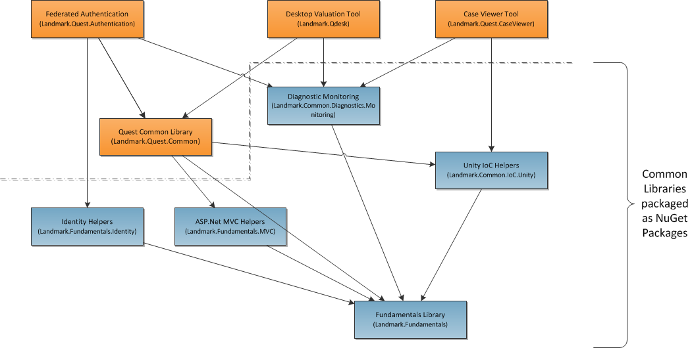
Why NuGet in the Enterpris?

Slide 7
NuGet within the Build Process.
NuGet Package Restore mode
No packages in source control
Gets the latest versions on each CI build
Manage packages at solution level
Upgrade all packages in solution at once
No packages in source control

Slide 8
NuGet within the Build Process.
Aside - NuGet Package Restore consent
In version 2.0 consent is required for Package Restore
Consent by checking the box in NuGet settings
Consent in NuGet.Config
Consent by setting Environment variable
See http://bit.ly/nuget-consent for details

Slide 9
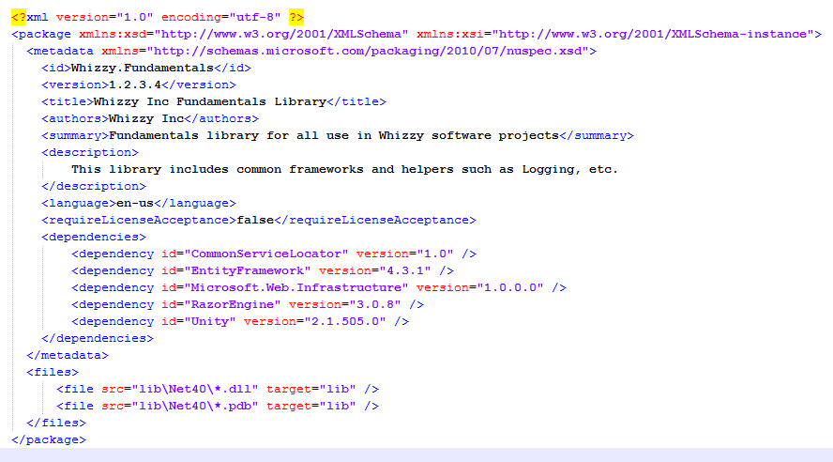
Packaging & publishing your code with NuGet.
Traditional / D.I.Y. method
Hand-crafted.nuspec file

Slide 10

Packaging & publishing your code with NuGet.
Traditional / D.I.Y. method
Hand-crafted.nuspec file
Nuget.exe post-build step to build package

Slide 11

Packaging & publishing your code with NuGet.
Traditional / D.I.Y. method
Hand-crafted.nuspec file
Nuget.exe post-build step to build package
Batch file / manual steps to publish

Slide 12
Packaging & publishing your code with NuGet.
Traditional / D.I.Y. method
Hand-crafted.nuspec file
Nuget.exe post-build step to build package
Batch file / manual steps to publish
This is the hard way!
Not good for Continuous Integration / Continuous Deployment
Hard to maintain

Slide 13
Packaging & publishing your code with NuGet.
Automated method – the EASY way
Nuget Package’n’Publish project template
Based on NugetPackageProject NuGet Package¹
Builds .nuspec file dynamically from AssemblyInfo.cs
¹. http://nuget.org/packages/NuGetPackageProject

Slide 14
Packaging & publishing your code with NuGet.
Automated method – the EASY way
NuGetPackageAndPublish.targets
MSBuild target integrates nicely with Continuous Integration / Continuous Deployment / Release Management
Release builds automatically publish to repository
/t:Publish
Properly versioned
This is how we do it at Landmark.

Slide 15
Demo time!
Demo: NuGet Package’N’Publish

Slide 16
Public? Private? Where should I publish?
File-based repository
Local / Network share
Trivially simple

Slide 17
Public? Private? Where should I publish?
File-based repository
Local repository server
NuGet.Server - http://nuget.org/packages/NuGet.Server
NuGetGallery - https://github.com/NuGet/NuGetGallery
Inedo ProGet - http://inedo.com/proget
$free → $395/yr or $995/perpetually

Slide 18
Public? Private? Where should I publish?
File-based repository
Local repository server
Cloud-based private repository
MyGet - http://www.myget.org/
$free → $21/pm
Enterprise option – p.o.a.

Slide 19
Demo time!
Demo: Private Repositories

Slide 20
Who pulled the plug? Coping with outages.
Hands up if…

Slide 21
Who pulled the plug? Coping with outages.
Hands up if…
You already have a cache (or two) !
The “HanselFix™” – add NuGet’s cache as a repository
C:\Users\{me}\AppData\Local\NuGet\Cache
Solution “packages” folder contains them too.
Caching in your local repository
Just copy from your cache! (batch file / scheduled task)

Slide 22
Demo time!
Demo: Pulling the plug

Slide 23
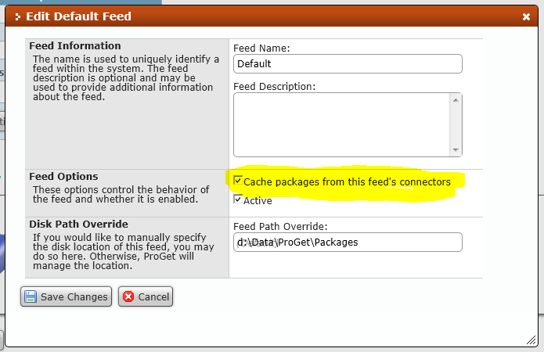
Who pulled the plug? Coping with outages.
ProGet 0.9
“Connector caching”
downloads packages as they’re pulled from connectors (NuGet.org or other repo)
I suggested that! ☺
MyGet.org doing something similar?

Slide 24
Conclusions
For a happy enterprise…
[Test]
public void TestThatMyEnterpriseIsHappy()
{
Assert.IsTrue( MyEnterprise.PackagesSharedLibraries );
Assert.IsTrue( MyEnterprise.TreatsSharedLibrariesAsProducts );
Assert.IsTrue( MyEnterprise.HasALocalRepository );
}

Slide 25
Hold on… Where’s the fun? Where’s the Profit?
The profit…
Is in REALLY re-using your code
Getting multiple dev teams working together
The fun…
Is in REALLY re-using your code
Getting multiple dev teams working together

Slide 26


One last thing…
As well as sponsoring DDDSW 4, also has open-sourced the NuGet Package’N’Publish tooling:
http://bit.ly/NuGetPnP

Slide 27
Questions?

Slide 28
Using your NuGet for Fun and Profit
Joel Hammond-Turner
E: joel.hammond-turner@landmark.co.uk
T: @Rammesses

